Slide 1
Rackspace Data 2015 Kickoff
Make Rackers Lives More Efficient

Slide 2
Agenda and Outcome of The Kickoff
Vision and Mission
What we need to accomplish with Data
How we will accomplish it
Organizations goals for 2015
Breakout Sessions
What you should get out of this
Understanding of the direction of the new data organization… “Focus on Datasets”
Knowledge of what we as a group need to accomplish for 2015
Understanding of where you can contribute and how we can complete our work

Slide 4
Use data to develop efficient organizations
Mission
Nick Kolegraff

Slide 5
Embedding Data into Company DNA
Experimental (See if it works)
Derivative Datasets (BU Specific)
Core Datasets
Questions as Requirements
Empower users across Rackspace with Relevant Datasets
Evolution path for datasets

Slide 6
How do we define datasets?
Core Datasets – (Rackspace Certified)
We have identified the key characteristics of data for it to be trusted. Only select views of data which are necessary and useful across all departments will be in the core dataset ecosystem
Derivative Datasets – (Self-Certified)
Specific business units will need to create their own unique views of information to run their business effectively – this work will be done by data analyst teams outside the Core Dataset team with the purpose to serve their specific business unit, but still follow a standard methodology consistent with data analyst teams. Should we find derivative data becoming useful to other business units the Data Analyst teams should work with the Core Dataset team and the data decisions group to get those attributes integrated into the Core.
Experimental Data
We still want to foster creativity and enable data innovation at Rackspace. Teams should be enabled to run experiments on new sources of data and new ways of capturing data that would be beneficial to Rackspace as a company. These datasets will be produced in an off-standard way with limited restrictions. However, should they evolve into something useful for the company an evolution path to the Core Datasets will need to be created.

Slide 7
If you torture the data long enough...
it will confess to anything
--Ronald Coase; Professor Emeritus of Economics; University of Chicago

Slide 8
An organization of data specialists to fix our internal problems then expand to customer problems.

Slide 9
Premise of Data
People want access to relevant and verifiable information, faster.

Slide 10
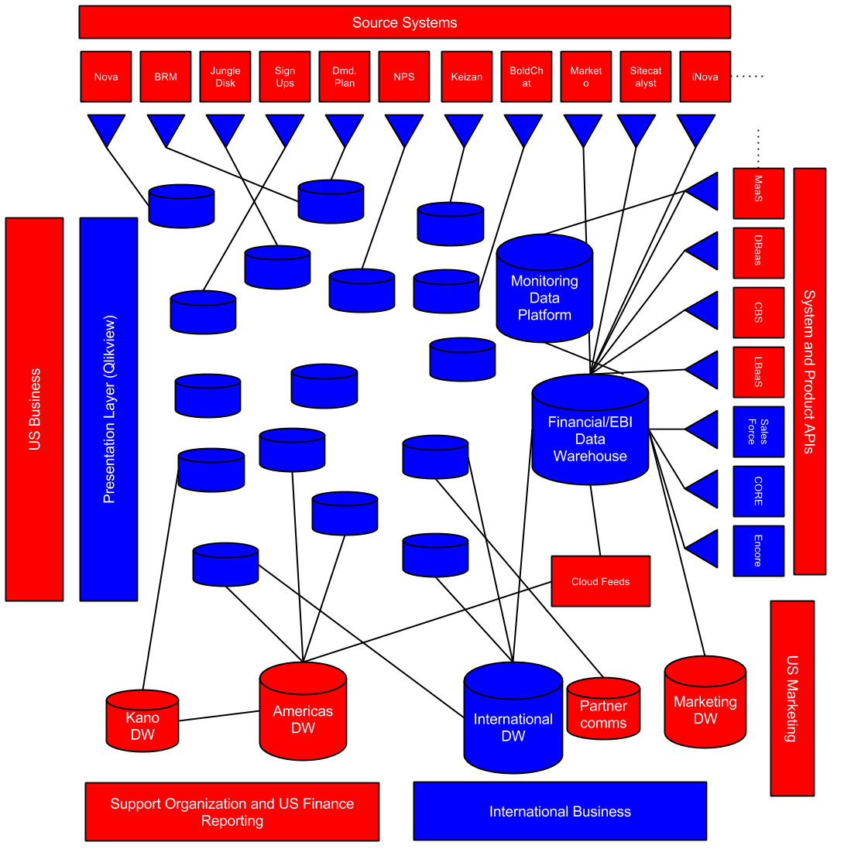
Data: Current State

Slide 11
VERBATIM
-19
“The turnaround time is longer than it should be. Any senior employee should be able to instantaneously access the data and manipulate tables to get what they need.
Further, the data often conflicts other sources in other parts of the company. Data must drive more decisions at the Rack.”
Data Warehouse NPS
Q4 2014
Director +

Slide 12
6 Things We Need To Do To Accomplish Premise
Consolidated Views of Quality Data
Verifiable quality
Focus on:
API/s
Specify a format
Time to Realized Information
From the birth of new data to the time it takes a Racker to access it in production/presentation. 3 week goal.
Self-Service
Accessibility
Transparency
Tickets
Infrastructure
Customer Experience
Usage
Average Query latency (non-crappy queries) < 10s
Focus is on customer experience
Push your data to us vs. we come to you.
Rackers can have access to consolidated views of data with or without SQL
Flat, Dimensional, and Cubes
Make onboarding to the new data quick and easy.
Collaborative Data Dictionaries
Open about what we do with the data
Visibility on how we verify the data
Documents on how to access and onboard to new data

Slide 13
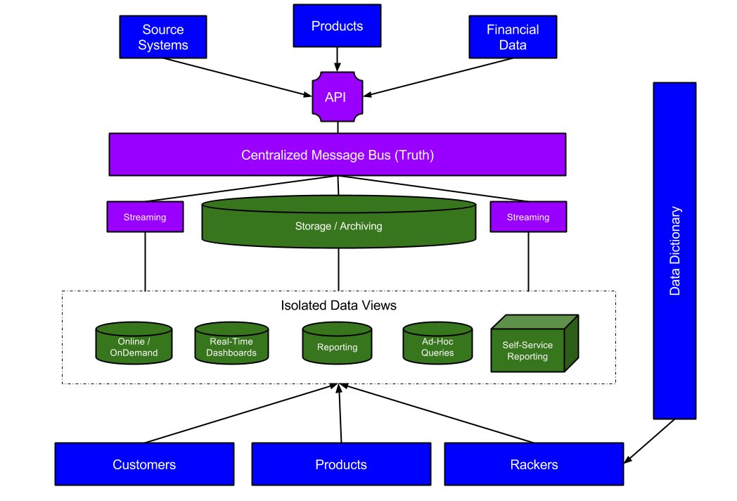
How we will deliver Datasets.

Slide 14
Guiding Themes For How We Do Work
Datasets are Products – we should develop them as such.
Eat our Veggies – If we are selling it, we should try to use it.
Relaxed Urgency.
Simplicity over Complexity
Fail Fast. Learn from it. Adjust quickly.
Focus on the data, not the technology.
Verifiable quality in everything we do. (Data Science the Data Itself)
Requirements as Questions – If we know the questions, designing the data is easy.
Leverage existing software and assemble. Custom code where absolutely necessary
Minimize Time to Realized Information: The time it takes Rackers to get access to new data from birth to presentation
Special Forces: Execute hard. Execute Fast. Don’t sacrifice quality.
Force Simplification: Make it easy. Make it work.
Accessibility: Communicate and Document. Users should be able to onboard to a new dataset in a few hours – not weeks.
“Deploy anywhere” Platform agnostic data.

Slide 15
Expectations of Individuals Day-to-Day
Availability and Responsiveness of individuals on email and chat
Individuals progress is reported into team channel everyday
Work in Github with commits everyday. Not just code, docs and analysis too.
Frequent Peer Reviews .. and +1’s before changes merged
Work is tested and has justification for ‘working’
Make the right decisions for the data. Setting aside personal bias on technology
Collaborative with other team members, we are all in this together.
Healthy Debate, Data is the 3rd party
Raise blockers – don’t squat on limited productivity. Ask for help.

Slide 16
How we organize to drive focus and accountability.
Data Platform Team (The Data Lake) -- Responsible for the infrastructure and systems which house data from the source systems and expose datasets to the broader organization for accessible consumption.
Data Engineering Team (The Data River) -- Responsible for moving and transforming the data between systems and creating consolidated and integrated views of information around Usage, Tickets, Monitoring/Networking, and Customers (Sales, Marketing)
Data Operations Team – Responsible for monitoring and alerting engineering teams when and where data issues and system issues occur.
International Data Team (The Data Tap): Responsible for producing Financial, Sales and Operational datasets and BI solutions for the international business (EMEA & APAC). Ongoing globalisation, maintenance and development of critical business applications including the Net Revenue Tracker, OLAP Cubes, SLA Reporting
Data Architecture and Design Team -- Responsible for schema designs of the datasets which are housed in the respective systems then handoff schemas to the engineering team. Responsible for having a company wide-view on source systems and data points within the company and how to design them to meet Rackspace demands and needs.
Data Quality Engineering-- Responsible for validating assumptions of the quality checks around our datasets are actually producing verifiable information.
Embedded BI Teams (The Data Tap) – Responsible for delivering derivative views of datasets that are specific to the business unit they support along with developing static and ad-hoc reports that meet the needs of their respective business units
International BI + Embedded BI Teams
Accion
Data Engineering
Accion
Data Architecture
Accion
Data Quality Engineering (HCL)
Data Operations
(DataOps) HCL
Data Platform

Slide 17
Get Committed to Team and Individual Goals
Teams
Individuals
Success Goals
3 goals the team feels are reasonably accomplishable over the course of 6 months.
Stretch Goals
1-3 goals the team feels are pushing beyond your current role or capability and would start building skills towards the career path you want to head
Outstanding
Goals for which we do not document. Are accomplished along with Success and Stretch and simply create a DAMN factor.
Success Goals
3 goals you feel reasonably accomplishable over the course of 6 months
Stretch Goals
1-3 goals you feel are pushing beyond your current role or capability and would start building skills towards the career path you want to head
Outstanding
Goals for which we do not document. Are accomplished along with Success and Stretch and simply create a DAMN factor.

Slide 18


GET 2015 PRIORITIES Transition from Reactive to Proactive.
Fanatical Culture Valued member of a winning team on an inspiring mission
Fanatical Support® Up the Stack and Out of the Rack!
Fanatical Technology Make the Managed Cloud Real
Create one of the world’s greatest leadership cultures
Establish centralized intake & prioritization
Design products and tools that elevate Rackers and create value for customers
Build products where we can create unique value, otherwise integrate leading technologies
Global workforce is optimized for delivery
Create and deploy GET Rapid Response Team
Ensure every Racker has clear goals and commits to delivering with excellence
Deliver a trusted and simplified Data Platform while reducing the turnaround time for new requests
Simplify, streamline and operationalize the GET ecosystem

Slide 19
Global Data Team Goals

Slide 20
Data 2015 PRIORITIES Make Rackers Lives More Efficient
Fanatical Culture Valued member of a winning team on an inspiring mission
Fanatical Support® Up the Stack and Out of the Rack!
Fanatical Technology Make the Managed Cloud Real
Create one of the world’s greatest leadership cultures
Transparency: Verifiable Quality
Create Trust in Our Data
Make Rackers Lives More Efficient with Data
Accessibility and On-Boarding
Self-Service
Ensure every Racker has clear goals and commits to delivering with excellence
Responsiveness
Faster Turn-Around for New Data

Slide 21
Create Trust in our Data
Purpose:
Create a trusted environment in which Rackspace can store it’s data and make that data trusted and easily accessible to the company.
Data Availability SLAs on critical datasets to be available at start and end of business days irrespective of geographic locations
Build transparency tooling and visibility around our data quality and measures we are taking to ensure it’s accuracy and integrity.
Initial versions of Usage, Monitoring, and Ticket data running on the platform with 24/7 support
95% uptime of the global data platform
Increase daily delta of the number of queries asked by users of our support platform by 20%
Increase the number of users adopting the platform by 20%
Decrease daily delta of the number of the questions people have about our platform.
Positive NPS score and testimonials from customers
Goals:
Notes:
21

Slide 22
Accessibility and On-Boarding (Rackspace Data Dictionary)
Purpose:
To Provide Rackers with a single lens on the data available to them at Rackspace.
Goals:
Integration of Usage, Monitoring, and Ticket data into the data dictionary
Consistency across how Rackers find information they need at the company
Average of 50 unique users per day
New users can onboard to our datasets and write queries in 2 weeks
Notes:
22

Slide 23
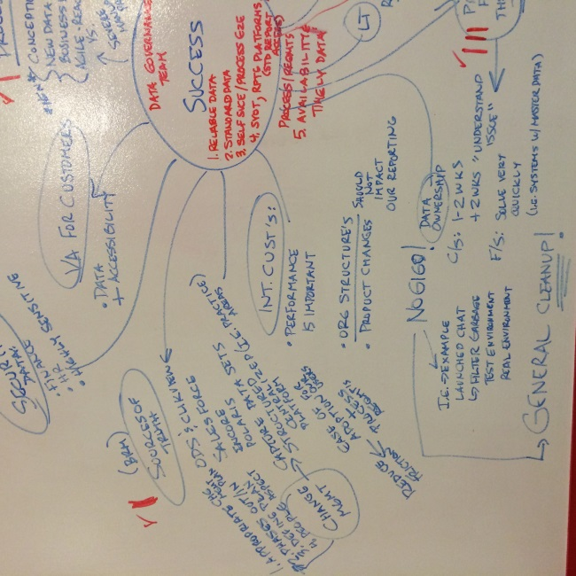
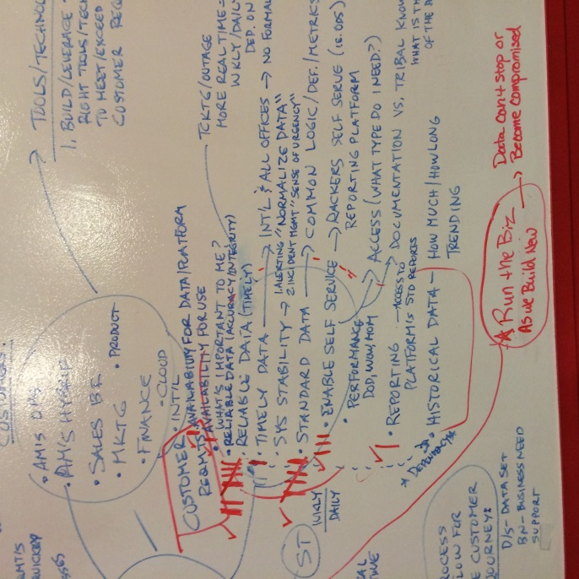
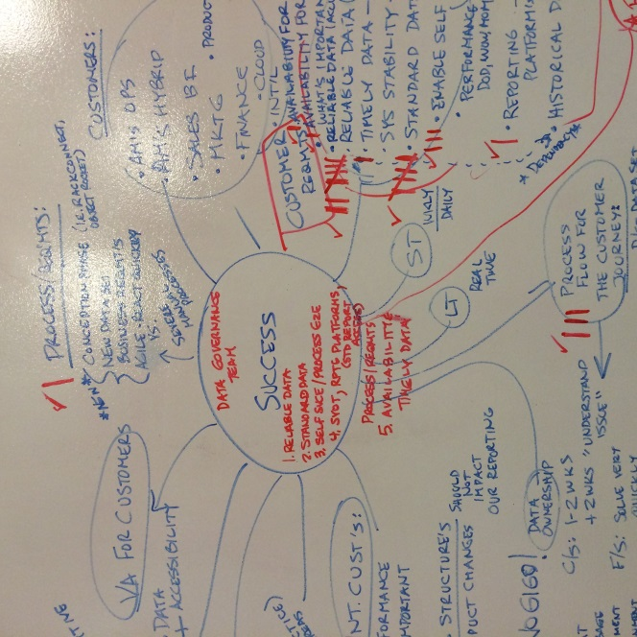
Brainstorming
Purpose &
Goals
Brainstorm
Framing
Task List
Project Schedule
Review &
Evaluation
Brainstorming Team:
Alaine Kotze — Finance US
Daniel Morris -- Product
Chris Caldwell — Marketing US
Andres Elizondo — Finance International
Andrew Kirby — Sales International
Robin Taylor — Marketing International
Patrick Booth — Support International
Kim Thorpe – RPC
Nick Kolegraff – GET
Brant Goering / Teresa Dophied – OE
Rachel Woodson – Support Operations
Andy Crockett – Marketing Operations
Larry Maya – Support Operations
Beckie Trevino – Cloud Support
Notes:
23

Slide 24
Framework
Purpose &
Goals
Brainstorm
Framing
Task List
Project Schedule
Review &
Evaluation
Data Platform
Reliable Data
Standard Data
Self Service
Data Simplification
Availability & Timely Data
Common Logic
Common Definitions
Common Metrics
Racker Self Service
Business User Friendly
Accuracy
Integrity
Timely
End-To-End Process
Consolidated views
Single points of Consumption
Source systems of Reference
International – All Offices
Notes:
24

Slide 25
2015 Global Data Roadmap
Stronger Sales and Marketing Capabilities
Self-Service Reporting Capability
Internal Use-Cases on Success with data platform
HC Rationalization
Q2
Q3
Q4
Q1
2015
Success Factors Finalized
Usage Dataset
Ticket Dataset
Monitoring/ Networking Dataset
Customer Dataset (dependency on Scott White’s team)
Data Governance
75% reduction of ODSs

Slide 26
The Data Organization 2015
What | Champion | Team | When | % Complete
The Data Organization 2015 | Nick
Run the Business
Objective – Maintaining and handling the day to day requests from the business and building solutions leveraging the existing data and infrastructure to build those solutions
Immediately: 2-3 months Centralize data intake into one process, which from the intake process we can determine which BI team makes the most sense to execute (i.e. Report Factory, Americas BI, UK BI, Ad-Hoc GET team. Set up a global data governance board to filter and prioritize business requests for reports. Optimize our current infrastructure as best possible by limiting access to the top most critical users as well as off loading on the ODS server by pinpointing which datasets can be moved to QVD without impacting the ODS server. BRM and Salesforce are likely starting candidates. Outsource the migration work to the dev center. Outsource any other legacy work and/or projects that need addressed in the immediate term to Report Factory and Dev Center. Identify reports to EOL that are consuming time/effort/resources | Nick | Patricia | 05/28 | 0%
Mid-Term: 4-6 months Define business logic for critical business metrics (DHR, DCR, Churn, Rated Usage, Uptime, Net Revenue, etc) Set up a logic committee to help define and uphold critical business metrics (CFO drives) | Nick | Patricia | 08/12 | 0%
Notes:
26

Slide 27
The Data Organization 2015
What | Champion | Team | When | % Complete
The Data Organization 2015 | Nick
Build the Foundation
Objective – Building the future data infrastructure and designing new data models that can scale and meet the demands of the business in the short term future (1.5 yrs)
Define functional categories to develop focused teams of 3-5 Rackers around each system and dataset | Nick | Patricia | 03/31 | 0%
Systems: Storage Platform for Staging and Archiving Isolated SQL Server Systems for User Sandboxing Cube Engine Ingest API for accepting new data sources and data attributes | Nick | Patricia | 06/15 09/15 12/15 06/16 | 0%
Datasets: Usage: Billing Events, MBU, Bandwidth, Atom Hopper Tickets: Core, Encore, Service Now, Zendesk, SA3, Ticket Fiend Monitoring/Networking/logs: Rackwatch, Sitescope, Nimbus, Scom, Zenoss, RADAR, MaaS, and all suppression associated, API Logs, Repose, Stacktach Customers/Clickstream: Site Catalyst, Salesforce, Chat, Avaya (UK phone system), MyRack, Omniture | Nick | Patricia | 05/15 08/15 11/15 02/16 | 0%
Notes:
27

Slide 28
The Data Organization 2015
What | Champion | Team | When | % Complete
The Data Organization | Nick
Build the Foundation
Mid-Term: 9 Months Stabilize our existing environment by leveraging industry best practices on an infrastructure that suits the skills of the analysts in the company (SQL Server) Stand up a postgres cluster with industry best practices architecture and configuration management so we can stage the data in Postgres to reduce licensing costs. Integrate UK cloud cube and Billing Events Schema Designs into a single model – call it something different. Redesign the model to be more centered around ‘usage events’ to handle things like Nova Event rollups and have the billable aspect be a dimension flag for the events. ETL data from ODS source systems into new model and migrate the data to the new platform Re-map the Net Revenue Tracker to the new Events Source – showcasing consistency and stability Leverage the UK self-service excel model to expose the events dataset to the global organization Leverage this model moving forward to tackle the remaining datasets around Tickets, Customers, Monitoring/Networking | Nick | Patricia | 06/15 09/15 12/15 | 0%
Notes:
28

Slide 29
The Data Organization 2015
What | Champion | Team | When | % Complete
The Data Organization | Nick
Build the Foundation
Long Term: 1 – 1.5 Years Define consumption standards for source systems. Develop an Ingest API for non-billing-events to publish to Assemble a small SWAT team (3-5 people, team to contract with is already identified) to track down the 80 source systems, rewrite the streams from each of the teams creating source systems to the API and/or give each source system a timeline to complete and if they can’t hit the date the SWAT team will do it for them. Take an ODS which has medium usage, NOVA_ODS and migrate those events through the API leveraging the Data Management Hadoop cluster (SOW written and agreed) as an archive for the events while pushing flat views of the events to Postgres Migrate a star schema to enable the integration of any new data and/or re-design take a more generalized approach around events, such as, event_type_dim table to specify which nova events we want to slice the dataset by. ‘instance-created’ would be a nova event type to aggregate by, for example. Repeat the above bullet points for all ODS. Giving access to those who truly need it. | Nick | Patricia | 06/15 09/15 12/15 06/16 | 0%
Notes:
29

Slide 30

Project Schedule
Brainstorm
Purpose &
Outcomes
Framing
Task List
Project Schedule
Review &
Evaluation
_{JAN}
_{FEB}
_{MAR}
_{APR}
_{MAY}
_{JUN}
_{JUL}
_{AUG}
_{SEP}
_{OCT}
_{NOV}
_{DEC}
RTB – Run the Business Plan (2-3 months)
Immediately: 2-3 months
Centralize data intake into one process
Set up a global data governance board
Optimize our current infrastructure
Outsource the migration work to the dev ctr
Outsource any other legacy work
Identify reports to EOL
RTB – Run the Business Plan (4-6 months)
Mid Term: 4-6 months
Define business logic for critical business metrics (DHR,DCR, Churn, Rated Usage, Uptime, Net Revenue, etc)
Set up a logic committee to help define and uphold critical business metrics (CFO drives)
Notes:
30
30

Slide 31
Project Schedule
Brainstorm
Purpose &
Outcomes
Framing
Task List
Project Schedule
Review &
Evaluation
_{JAN}
_{FEB}
_{MAR}
_{APR}
_{MAY}
_{JUN}
_{JUL}
_{AUG}
_{SEP}
_{OCT}
_{NOV}
_{DEC}
Build the Foundation Plan (9 months)
Mid Term: 9 months
Stablize our existing environment
Stand up a postgre cluster with best practices
Integrate UK cloud cube and Billing Events
ETL data from ODS source systems
Develop a decomm plan for the ODS environment
Re-map the Net Revenue Tracker to the new Events Source
Leverage the UK self-service excel model
Leverage this model moving forward to address dataset around Ticketing, Customers, Monitoring/Ticketing
Notes:
31
31

Slide 32
Project Schedule
Brainstorm
Purpose &
Outcomes
Framing
Task List
Project Schedule
Review &
Evaluation
_{JAN}
_{FEB}
_{MAR}
_{APR}
_{MAY}
_{JUN}
_{JUL}
_{AUG}
_{SEP}
_{OCT}
_{NOV}
_{DEC}
Build the Foundation Plan (1 to 1.5 yrs)
Long Term: 1 to 1.5 years
Define consumption standards for source systems
Develop a messaging system for non-billing events
Assemble small SWAT teams to track down 80 source systems
Take an ODS which has medium usage and migrate those events through the API
Migrate a star schema to enable the integration of any new data and/or re-design take amore generalized approach
Rinse and repeat for all ODS environments
Notes:
32
32

Slide 33
The Data Foundation Plan
Process Dependencies
Brainstorm
Purpose &
Outcomes
Framing
Task List
Project Schedule
Review &
Evaluation
_{JAN}
_{FEB}
_{MAR}
_{APR}
_{MAY}
_{JUN}
_{JUL}
_{AUG}
_{SEP}
_{OCT}
_{NOV}
_{DEC}
_{JAN}
_{FEB}
_{MAR}
_{APR}
_{MAY}
_{JUN}
_{JUL}
_{AUG}
_{SEP}
_{OCT}
_{NOV}
_{DEC}
Run the Business: 2-3 months
Centralize data intake into one process
Set up a global data governance board
Optimize our current infrastructure
Outsource the migration work to the dev ctr
Outsource any other legacy work
Identify reports to EOL
Run the Business: 4-6 months
Define business logic for critical business metrics (DHR,DCR, Churn, Rated Usage, Uptime, Net Revenue, etc)
Set up a logic committee to help define and uphold critical business metrics
Build the Foundation: 9 months
Stablize our existing environment
Stand up a postgre cluster with best practices
Integrate UK cloud cube and Billing Events
ETL data from ODS source systems
Develop a decomm plan for the ODS environment
Re-map the Net Revenue Tracker to the new Events Source
Leverage the UK self-service excel model
Leverage this model moving forward to address dataset around Ticketing, Customers, Monitoring/Ticketing
Build the Foundation: 1 to 1.5 years
Define consumption standards for source systems
Develop a messaging system for non-billing events
Assemble small SWAT teams to track down 80 source systems
Take an ODS which has medium usage and migrate those events through the Ingest API
Migrate a star schema to enable the integration of any new data and/or re-design take amore generalized approach
identify the message system as the new source
Rinse and repeat for all ODS environments
Daily Update Meetings
Notes:
33
33

Slide 34
Team Breakout Sessions
Break into Dataset and Platform Teams
Datasets
Usage
Tickets (Support)
Infrastructure
Customer Experience
Platform
Archive
Warehouse
Isolated Views

